Slide 1
Microsoft Azure ARCHITECT AZ 303
Training By: Pravin M

Slide 2
Day wise Agenda
Day1: Introduction to Microsoft Azure and Its Services
Day2: Azure Virtual Machines and Networking
Day3: Azure VMSS and Availability zones
Day4: Azure App Services and Its Features
Day5: Advanced Azure Hybrid Connectivity and Site Recovery
Day6: Azure Storage Solution and Design Patterns
Day7: Azure Kubernetes Service
Day8: Azure Active Directory and Role Based Access Control
Day9: Azure Messaging Service (Events, Hubs, Queue and Bus)
Day10: Azure Monitoring and Insights Service

Slide 3
DAY 1
Understanding Cloud computing in General
After completing this module, you should be able to:
Create and Manage Azure Subscriptions
Create and Manage a Free Tier Azure Account
Deploy Azure Resources through Azure Portal
Understand Azure Storage Services
Identify various Storage Types

Slide 4
Introduction

Slide 5
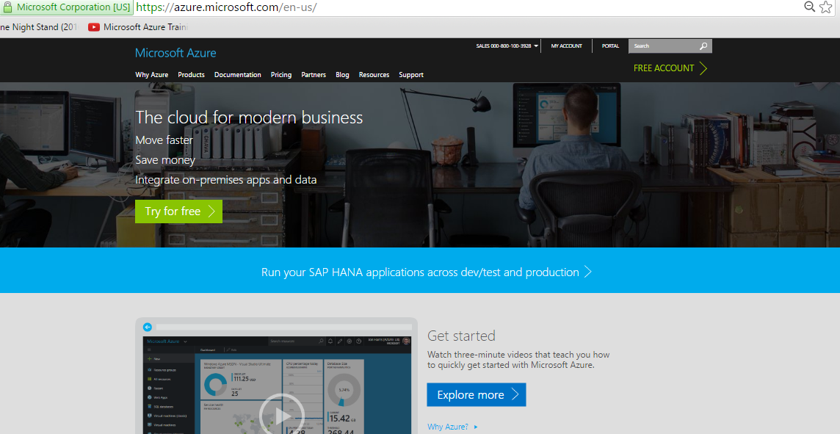
Setting up a 30 day Trial Subscription

Slide 6
What is cloud computing?
Cloud computing is something that
An approach to computing that’s about having the right resources at the right time, and connecting to a variety of devices and endpoints.
Notes:
The computing that is done in the cloud i.e. over internet.

Slide 7
How cloud is different from Normal servers
Notes:
In a cloud when you copy the data over one datacenters, the data will get replicated within fraction of seconds to other datacenters providing you high availability.
You can select your particular region where you can store your data.

Slide 8
“
Its all about Services!
Not just about servers
”

Slide 9
Cloud computing?
Delivering computing services like servers, storage databases, networking, software, analytics and more over internet.
Types of cloud computing
A. Infrastructure as a Service
B. Platform as a Service
C. Software as a Service

Slide 10
Pizza as a Service

Slide 11
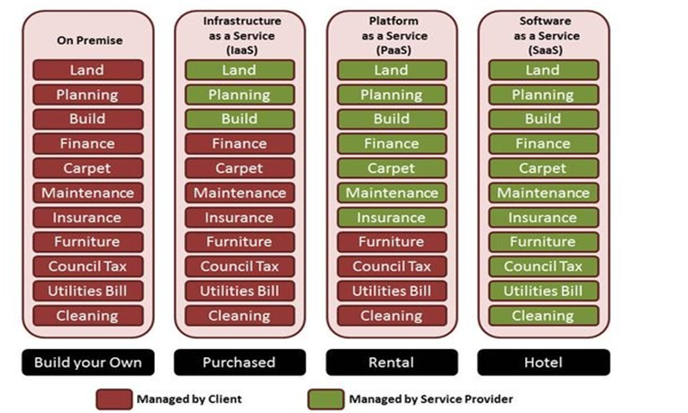
House as a Service

Slide 12
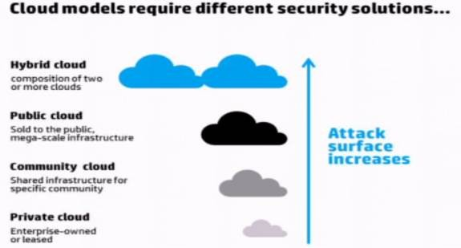
Cloud Deployment Models

Slide 13
Cloud Deployment models characteristics
Private Cloud:
Supports all users from within company itself
Managed by the organization itself
More expensive than public clouds due to the capital expenditure
Able to address the security and privacy concerns of organizations today
Public Cloud:
Supports all users who want to make use of a computing resource
Subscription is required for signup
Pay as you go model
Increase capacity as and when needed
Community cloud:
Supports multiple organizations sharing computing resources that are part of a community
Access to a community cloud environment is typically restricted to the members of the community
Hybrid cloud:
An organization makes use of interconnected private and public cloud infrastructure

Slide 14
Understanding on Setting up Azure subscription
Demo

Slide 15
Azure Account, Manage Group, Tenant and Subscriptions
Azure Account is the email and password that allow you to login into Azure.
An Azure account is a user identity, one or more Azure subscriptions, and an associated set of Azure resources.
The person who creates the account is the Account Administrator for all subscriptions created in that account. That person is also the default Service Administrator for the subscription.
Azure subscriptions help you organize access to Azure resources.
Each subscription can have a different billing and payment setup, so you can have different subscriptions and different plans by office, department, project, and so on.
Every service belongs to a subscription, and the subscription ID may be required for programmatic operations.

Slide 16
Azure Account, Manage Group, Tenant and Subscriptions
Multiple subscriptions can trust the same Active directory, but each subscription trusts only one Active directory.
A Tenant is a dedicated Azure AD service instance that an organization receives and owns when it signs up for a Microsoft cloud service such as Azure, Microsoft Intune, or Office 365.
Each Azure AD tenant is distinct and separate from other Azure AD tenants.
A tenant is an instance of Azure Active Directory. cloudcognoscente.onmicrosoft.com is an example of a tenant.
Billing for Azure services is done on a per-subscription basis. If your account is the only account associated with a subscription, then you are responsible for billing.
Azure AD is identity system for Microsoft business services.
If you create a subscription with a personal account, an Azure AD tenant is created for you.
Subscriptions can be transferred between Azure AD tenants.

Slide 17
Azure Deployment Models
There are two way to deploy your resources is Azure: The Classic and the Resource Manager Model.
For this exam (Azure 300) and due to MS recommendations, we are only interested in
Azure Resource Manager (ARM) Deployment Model.
In classic Model, each resource is independent, no way to group resources.
In ARM Model, you can use Resource Group to group all the dependent resources together.

Slide 18
Terminology
Resource: The Azure service that you create: VM, Vnet, Subnet, NIC, IP Address, etc
Resource Group: Container that hold the related resources for an Azure solution.
Resource Provider: A service that supply the resources: Microsoft.compute,
Microsoft.Storage, Microsoft.Network
Resource Manager Template: A Java Script Object Notation (JSON) file that define azure resources.
The resources in a Resource Group can allocated in different regions. But each resource can only be a member in one resource group. (ex. 1 VM can only be in 1 Resource group)

Slide 19
Ways to deploy Azure resources
There are multiple ways you can deploy resources in Azure
Portal.azure.com
ARM Templates using JSON file
Azure PowerShell
Azure CLI
Microsoft SDKs for different languages
Ansible/Terraform
By using a JSON file you can deploy the whole Azure Solution together, whereas in the PowerShell or Power CLI you need to deploy each resource individually.

Slide 20
Azure Portal and Cloud Shell
The Azure Portal let's you build, manage, and monitor everything from simple web apps to complex cloud applications in a single, unified console.
Search resources, services, and docs.
Manage resources.
Create customized dashboards and favorites.
Access the Cloud Shell.
Receive notifications.
Links to the Azure documentation.

Slide 21
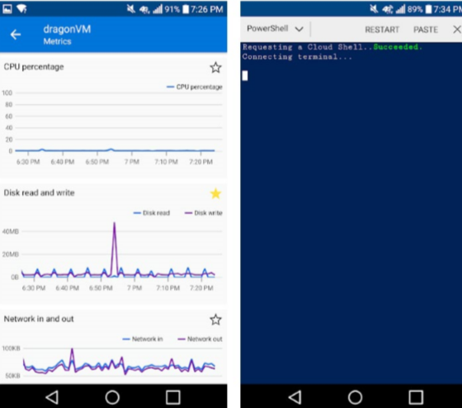
Azure Mobile App
The Microsoft Azure app helps you keep track of your resources while on-the-go:
Stay connected to the cloud and check status and critical metrics anytime, anywhere.
Diagnose and fix issues quickly with Azure Mobile.
Run commands to manage your Azure resources.

Slide 22
Demo – Cloud Shell
Configure the Cloud Shell
Experiment with Azure PowerShell
Get-AzSubscription
Get-AzResourceGroup
Experiment with the Bash shell
az account list
az resource list

Slide 23
Azure PowerShell and CLI
A PowerShell command is called a cmdlet (pronounced “command-let”). A cmdlet is a command that manipulates a single feature.
Cmdlets follow a verb-noun naming convention; for example, Get-Process, Format-Table, and Start-Service. There is also a convention for verb choice. You can use Get-Verb to retrieve examples, such as:
● get retrieves data.
● set inserts or updates data.
● format formats data.
● out directs output to a destination.
Azure PowerShell is a module that you add to Windows PowerShell or PowerShell Core to enable you to connect to your Azure subscription and manage resources.

Slide 24
Az module
Az is the formal name for the Azure PowerShell module containing cmdlets to work with Azure features. It contains hundreds of cmdlets that let you control nearly every aspect of every Azure resource. You can work with the following features, and more:
● Resource groups
● Storage
● VMs
● Azure AD
● Containers
● Machine learning

Slide 25
Understanding on Azure AD Tenant
Demo

Slide 26
Configure Cost Center Quotas and Tagging
The most used ways to manage costs in Azure:
Filters inside Subscription → Cost Analysis → Resource groups
Filters inside Subscription → Cost Analysis →Tag
Multiple Subscriptions
Tag is used to logically organize resources for billing purpose: the form of the tag is: [Name] : [Value]
You could add a policy to force adding tags to Subscriptions and Resource groups.

Slide 27
PowerShell Commands
$PSVersionTable.PSVersion
Install-Module -Name Az -AllowClobber -Scope CurrentUser
Login-AzAccount
Get-AzResourceGroup
New-AzResourceGroup -Name rg2 -Location 'East US'
New-AzStorageAccount -ResourceGroupName rg2 -Name <provideNameOfStorageAccount InSmallCase> -SkuName Standard_LRS -Location 'Central India' -Kind Storage

